Slide 1

CS401 Modern Programming Practices (MPP) Professor Renuka Mohanraj
MAHARISHI UNIVERSITY of MANAGEMENT
Engaging the Managing Intelligence of Nature
Computer Science Department

Slide 2
© 2015 Maharishi University of Management, Fairfield, Iowa
All rights reserved. No part of this slide presentation may be reproduced or utilized in any form or by any means, electronic or mechanical, including photocopying or recording, or by any information storage and retrieval system, without permission in writing from Maharishi University of Management.

Slide 3
Lecture 5: Abstract Classes and Interfaces
Engaging Abstract Levels to Enrich Life

Slide 4
Wholeness of the Lesson
Both abstract classes and interfaces can be used in conjunction with polymorphism, but interfaces provide even more flexibility. Likewise in the universe, objects form hierarchies of wholeness which express the unmanifest field of pure creative intelligence into all the specific structures of existence and intelligence.

Slide 5
Abstract Classes and Methods
When a class is declared to be abstract, it cannot be instantiated directly.
When a method in a class is declared abstract, it means no implementation of the method is provided, and it must be implemented by a subclass.
When a method is declared to be abstract, its enclosing class must also be declared abstract.
Abstract classes may include instance variables and other non-abstract (implemented) methods

Slide 6
Abstract Class Example
public abstract class Product {
private String productId;
public abstract double getPrice();
public String getProductId() {
return productId;
}
public void setProductId(String productId) {
this.productId = productId;
}
}
Stereotype
public class Bicycle extends Product {
@Override
public double getPrice() {
return 230.45;
}
}

Slide 7

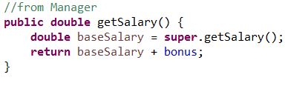
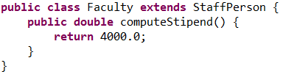

Abstract Classes and Polymorphism
When using polymorphism:
Default implementation. Sometimes, a method common to subclasses has a natural default implementation. Example: The getSalary method of Employee. (Lesson 3)
Abstract method. At other times, a common method has no default implementation and so it is declared abstract – the implementation of the method in this case must be handled by subclasses.
Example: The computeStipend method of StaffPerson (Lesson 3)

Slide 8
Java Interfaces(Pre Java 8)
A Java interface is like an abstract class execpt:
No instance variables or implemented methods can occur. [Public static final variables can be defined, but not instance variables.]
Can implement more than one interface. [Note: no class can have more than one superclass.] Syntax:
MyClass implements Intface1, Intface2, Intface3
Can also extend and implement. Syntax:
MyClass extends SuperClass implements Intface1, Intface2 Example: In Java, ArrayList implements 6 interfaces and extends one class. (What are they?)
Other features:
One interface can extend another. Example: List extends Collection
In many cases, when an abstract class is used for polymorphism, an interface could be used instead.
All methods in an interface are automatically public and abstract
Notes:
Example: In Java, ArrayList implements 6 interfaces and extends one class. (What are they?)
public class ArrayList<E> extends AbstractList<E>
implements List<E>, RandomAccess, Cloneable, java.io.Serializable
List<E> extends Collection<E>
Collection<E> extends Iterable<E>

Slide 9
Interface Example
public interface IProduct {
public abstract double getPrice();
}
UML has two different
notations for Interfaces
public class Bicycle implements IProduct {
@Override
public double getPrice() {
return 230.45;
}
}
interface stereotype
Bicycle
<<interface>>
IProduct
+getPrice()
+getPrice()
realizes
Question: Is there a good reason to use an interface instead of an abstract class?

Slide 10
Interface Example
public interface IProduct {
public abstract double getPrice();
}
Vehicle
public class Bicycle extends Vehicle
implements IProduct {
@Override
public double getPrice() {
return 230.45;
}
}
One benefit: Bicycle can be treated as
a subclass of Vehicle at the same time as
it implements IProduct (as does every product in our system).
Bicycle
<<interface>>
IProduct
+getPrice()
+getPrice()

Slide 11
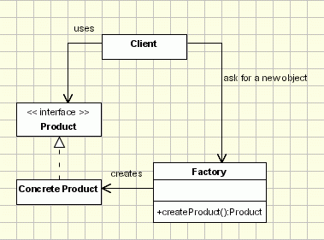
Application of Interfaces: Object Creation Factory

Slide 12
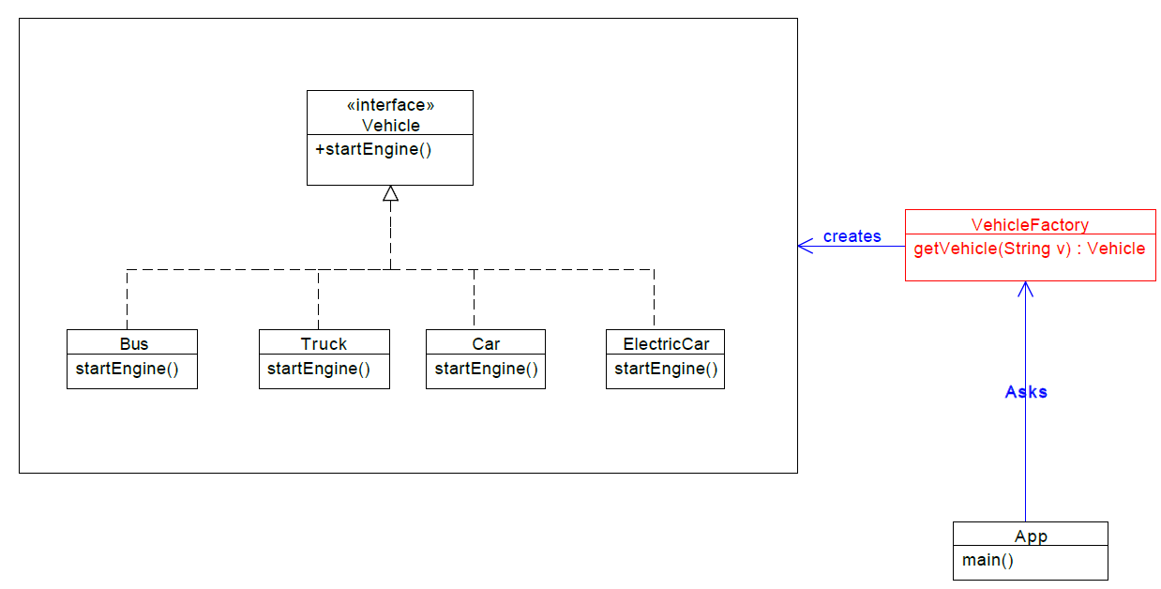
Application of Interfaces: Object Creation Factory

Slide 13
Examples of Object-Creation Pattern
In Java’s Collections class, there are 32 static factory methods.
Examples:
public static <T> List<T> unmodifiableList(List<T> list) public static <T> List<T> synchronizedList(List<T> list)

Slide 14
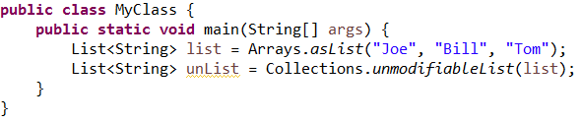
Exercise 5.1
The following lines of code make use of one of the factory methods in Collections. Compare these with the Object Creation Factory pattern diagram, and answer the following:
1. Which class plays the role of Factory?
2. Which class plays the role of Client?
3. Which interface plays the role of Product type?
4. Which class plays the role of Concrete Product?(Specific type)

Slide 15
Solution
Factory – Collections, Arrays
Client – MyClass
Product – List<String>
Concrete Product – Anonymous implementors of List

Slide 16
Factory Method Pattern
The Factory Method Pattern gives us a way to encapsulate the instantiations of concrete types.
The Factory Method pattern encapsulates the functionality required to select and instantiate an appropriate class, inside a designated method referred to as a factory method.
The Factory Method selects an appropriate class from a class hierarchy based on the application context and other influencing factors. It then instantiates the selected class and returns it as an instance of the parent class type.
The advantage of this approach is that the application objects can make use of the factory method to get access to the appropriate class instance.
This eliminates the need for an application object to deal with the varying class selection criteria.

Slide 17
Advantages of Using Object-Creating Factory Methods
Factory methods have a name – easier to understand what is being requested, and to distinguish between different kinds of invocations on an object. (Imagine a class that has 5 different constructors – how can you tell what each one does? A good example is the List creation methods in Collection.)
Can control access to instances. (See the Student/GradeReport and DataAccess examples, upcoming)
Solves the problem that a class can have only one constructor with a given signature. (See Triangle example ,upcoming)
Unlike constructors, factory methods are not required to create a new instance every time they are invoked. (See Singleton creation example.)
Unlike constructors, factory methods can return a subtype of the requested type. (See RuleSet getRuleSet() in Rules Framework example – a subclass of RuleSet is returned)
Simple example of Factory Pattern :
lesson5.lecture.factorypattern.myexample.pizzas;

Slide 18
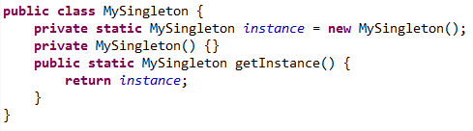
Simple Factory Methods
Much of the benefit of having a separate factory to create instances of objects (like the Collections class to produce different kinds of Lists) can be realized by just having a special “create” function inside a class to provide instances of the class – also called a factory method
Example: In this Singleton implementation, you control how many instances are created by using a factory method to provide the instance

Slide 19
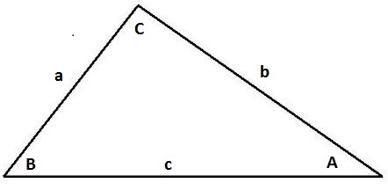
Application: Problem of Multiple Constructors with Same Signature
Sometimes you may have a class that should provide two (or more) constructors that do different things, accept different input arguments, but the arguments are all of the same type. Java does not allow you to overload constructors with identical signatures. Using factory methods solves this problem
Triangle Example. By the laws of geometry, we can specify a triangle by specifying three of its sides, or by specifying two sides and the included angle. See demo: lesson5.lecture.factorymethods5.triangle
class Triangle { Triangle(double s1, double s2, double s3) { side1 = s1; side2 = s2; side3 =s3; }
Triangle(double s1, double s2, double inclAngle){ side1 = s1; side2 = s2; angle3 =inclAngle; } }
Notes:
// This is not allowed, produce compilation error

Slide 20

Application: Controlling Access to Instances
Student/GradeReport Example. We wish to maintain a bidirectional 1:1 relationship between Student and GradeReport when data for these is read from a database. We wish to guarantee that instances of these classes are created in just the right way. After instances of each are created, we want to make sure that classes are read-only (i.e. immutable). To do this we:
Create instances using a Factory
Keep all classes related to GradeReport and Student in the same package
Provide only package level access for all constructors and setters
Declare all classes in the package final
See lesson5.lecture.factorymethods6

Slide 21
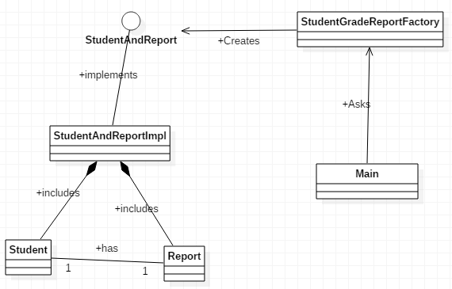
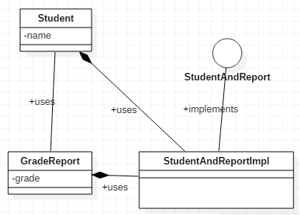
<<interface>>

Slide 22
Application: Controlling Access to Instances - continued
Data Access Example. We wish to provide restricted access to the database. Data access requests must come through a designated package. Special classes (called Daos) will be allowed to send in data to be saved and to make requests for data. To accomplish this we
Designate a dataaccess package
Provide a factory to produce instances of the DataAccessSystem, typed as an interface DataAccess
Make all setters and constructors of classes in the package have package level access
Require entity classes like Address or Person to make use of corresponding Dao classes, like AddressDao, PersonDao to communicate with the data access layer
See lesson5.lecture.factorymethods3.dataaccess
Notes:
business logic or domain logic is the part of the program that encodes the real-world business rules that determine how data can be created, stored, and changed.
An ordinary Java class that is marked (annotated) as having the ability to represent objects in the database. Conceptually this is similar to serializable classes, which are marked as having the ability to be serialized.

Slide 23
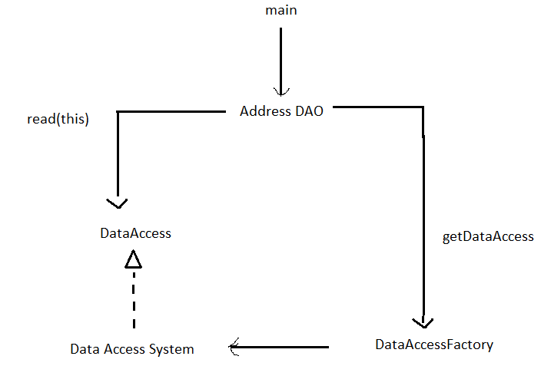

Slide 24
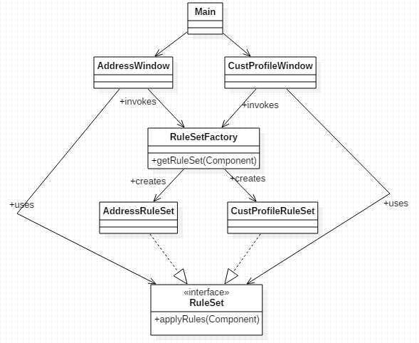
Parametrized Factory Methods
Factory can produce different implementations of an interface based on input parameter. Example: Rules Framework see lesson5.lecture.factorymethods2
Notes:
How the rulesets go with the window.
Framework decide what Ruleset have to use.

Slide 25
Issues When Using Factory Methods
Classes without public, protected, or package-level constructors cannot be subclassed (when factory methods are used, usually the constructor is private)
The factory method name must be distinguished from other static methods.
Use conventional naming
getInstance [often used to invoke a Singleton]
newInstance [used in Class to obtain an instance from a class]
getType
newType
openConnection [URLConnection example]3
valueOf [BigInteger.valueOf(long)]
of [LocalDate.of(year, month, day)]

Slide 26
Interfaces as Types
Primitives (int, float, etc) are examples of simple types
Classes provide an ‘interface’ and an implementation
In this context the interface is ‘The publicly exposed methods’ – the services provided by the class.
This ‘interface’ is therefore a way of specifying the type
A Java Interface provides a pure ‘type’ – an abstraction of a class.
Just specifies what you can do with an implementer of the interface

Slide 27
Interfaces and Polymorphism
Since interfaces are types like classes, they can be used in the same polymorphic ways that classes can be used. [For these examples, recall that List is an interface in the Java collections library]
As variable type:
List<Student> students = new ArrayList<Student>();
As argument type:
public void createTranscripts(List<Student> students)
As return value type:
public List<Student> findStudents(String country)
See Demos in lesson5.lecture.intfaces1, lesson5.lecture.intfaces2

Slide 28
Multiple Inheritance in Other Languages (like C++)
Diamond Problem
Which (conflicting) implementation do we use?
Note there is no conflict among the types (interfaces) declared by the different classes
Which version of method()
does D inherit?

Slide 29
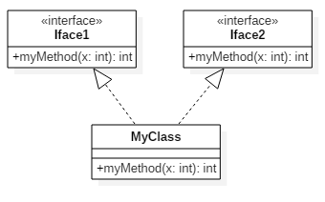


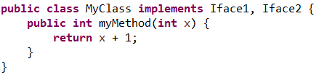
Exercise 5.2
Does the following code compile and run? Explain
Notes:
Answer is : Yes. Interface methods are by default abstract and unimplemented in Pre-Java-8. So no collision.

Slide 30
Java’s Answer (pre - Java SE 8)
Implementation can be ‘inherited’ / extended only once
Types can be ‘inherited’(one interface can extend another interface) / implemented multiple interfaces in a class
No limit on the number of interfaces you can implement
A single interface can extend other interfaces
Dog ‘is a’:
Animal, Pet, and Companion

Slide 31
Interface vs. Abstract Class: Pre-Java 8
Interface has no implementation
Important types should always be interfaces to allow for ‘multiple’ inheritance
Interface takes abstraction one step further.
Abstract class is an abstraction of its subclasses – provide common implementation.
Interface is an abstraction of its (abstract) subclasses – provides common type.

Slide 32
Some Advantages of Interfaces
They support the safe part of multiple inheritance
They enforce information hiding and encapsulation.
Remember encapsulation is about grouping data and methods together for ease of use. Information hiding hides the implementation from the public ‘interface’.
They support change - Interfaces are declared independently of classes, they are unaffected by changes to specific classes or to the class hierarchy as a whole.
They support development of code in parallel – each team can rely on other teams interfaces even before they are implemented.
Notes:
An Interface type name that can be used to declare objects of the type. The type determines allowable operations on the type. Hidden implementation : The implementation operations is hidden from users of the type.
Program is more portable. It can be compiled and executed based on the implementations.

Slide 33
Flexibility of Interfaces
Interfaces let you take greater advantage of polymorphism in your designs, which in turn helps you make your software more flexible.
In your small groups modify this class hierarchy so it supports display of images (like bitmaps and png’s).
[Use an interface to
create greater
abstraction.]
draws

Slide 34
A Solution
With an interface, we can easily add a new class hierarchy
GraphicWindow
<<interface>>
draws
IDrawable
+display()
+draw()
+erase()
+move()
<<abstract>>
Shape
-x
-y
-color
+draw()
+erase()
+move()
Rectangle
Circle
-width
-radius
-height
+draw()
+draw()
+erase()
+erase()
+move()
+move()

Slide 36
Interfaces Support Team Development
First define the interfaces for all subsystems, then every programmer can program one subsystem by using the interfaces of the other subsystems.
The implementation of subsystems may change without affecting all other subsystems, as long as the interfaces remain the same.

Slide 37
Interfaces in System Development
If you have a subsystem that represents an abstraction that may have multiple implementations, whether the subsystem is a single object, a group of objects, an entire Java applet or application, you should define Java interfaces through which the rest of the world communicates with that subsystem.
When you use interfaces in this way, you decouple the parts of your system from each other and generate code that is more flexible: more easily changed, extended, and customized.
Program to Interface (P2I), rather than implementation.

Slide 38
Best Practices: When to Use Interfaces?
Always use interfaces for subsystem development
Prefer interfaces over multiple levels of abstract classes
If an abstract class will provide all the abstraction you need, then do not add an interface.
Make code as simple, elegant, and clear as possible.
“as simple as possible, but no simpler” (Einstein)

Slide 39
The Evolving API Problem
Problem: You have created a library of Java classes and you have a substantial clientele(customers) who make use of your library. Your library contains numerous interfaces, for which you have implementations (in some cases, multiple implementations) in your library code.
Suppose you now want to add new functionality to your library. In many cases, you will need to add new methods to some of your interfaces. You think “I have to be careful not to change the signature of my interface methods, but adding new methods should not create a problem for my users.” You add some methods, and distribute a new release.
A few days later you get hundreds of complaints that your new code has broken the code of your clients who were using your library. What went wrong?

Slide 40
Explanation:
Clients created their own implementations of your interfaces, in earlier versions of your code. When you add new methods to those interfaces, their code breaks because they do not have implementations of the new methods.
New features of interfaces in Java 8 provide a solution to this and other issues concerning interfaces.

Slide 41
Main Point
Abstract classes and interfaces are both strongly related to the concept of Inheritance.
The interface is the most abstract entity in the class diagram, and by programming to interfaces, we generate more flexible code.
Greater abstraction holds the possibility of greater potential; this principle is especially evident in the case of the unified field.

Slide 42
Summary
Today we looked at modeling abstractions through Inheritance, abstract classes and interfaces. We also looked at the design decisions that go along with using them:
Abstract classes and interfaces contain less and less implementation details, and instead focus more on general abstract parts (like types)
With Java it is important to always “Program to Interface”.
Use interfaces for ‘multiple’ inheritance, encapsulation, flexibility, and parallel development.

Slide 43
